Slide 1



Programme Overview
Enabling maternity teams to work safely

Slide 2

Our throughline
Helping maternity units to build the right culture, behaviours and conditions that enables effective clinical escalation

Slide 3
The Programme
“Learn”
Each Baby Counts Learn and Support was a joint RCOG / RCM DHSE funded programme aiming to build the capacity of 16 NHS Maternity Professionals in clinical leadership skills, safety thinking, and quality improvement using behavioural science approach to design, test and evaluate interventions.
”Support”
This network of midwives and obstetricians from across England worked together co-design and implement interventions improve the culture, behaviours and conditions that enable effective clinical escalation in maternity units.

Slide 4
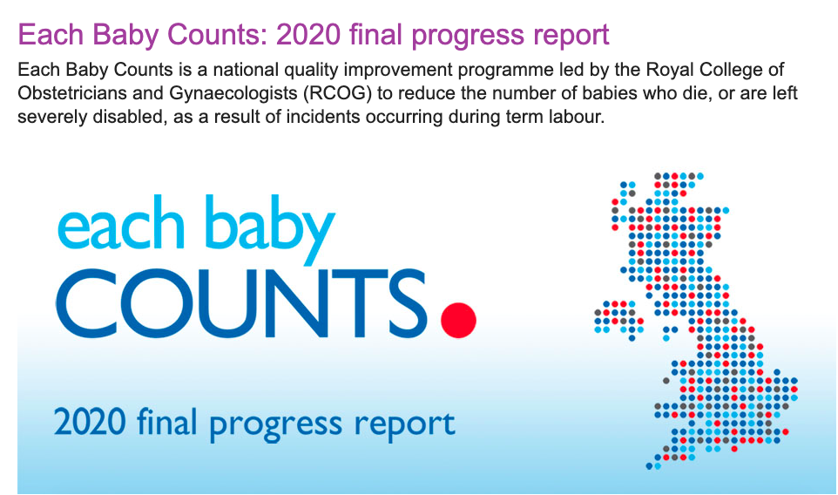
Background
Started in 2019 – finished March 2022
Core team: Midwives (x2), obstetrician, behavioural psychologist, research assistant, project manager, plus safety expert consultancy.
Built on the finding of EBC reports – putting recommendations into action

Slide 5
EBCL&S Approach
Learn:
Identify learning points on escalation from both national reports and local practice (diagnostics).
Workshops for the local leads focussed on developing clinical leadership skills, build capacity in Quality Improvement methodology and awareness of key safety concepts including psychological safety Safety II, civility, and strategies to aid effective communication.
Support:
Identify the barriers and facilitators of effective escalation in their settings
Co-produce interventions with input from their teams and women
Implement, test and evaluate interventions in their settings
Share widely across all maternity services

Slide 6









Maternity Safety

Slide 7
Participating units
University Hospitals of Morecambe Bay
Leeds Teaching Hospitals Trust
Calderdale and Huddersfield NHS Foundation Trust
Chesterfield Royal Hospital NHS Foundation Trust
Sherwood Forest Hospitals NHS Foundation Trust
East Cheshire NHS Trust
United Lincolnshire Hospitals NHS Trust
Wirral University Teaching Hospital NHS Foundation Trust
Norfolk and Norwich University Hospital NHS Foundation Trust
Royal Wolverhampton NHS Trust
East Suffolk and North Essex NHS Foundation Trust
West Hertfordshire Hospitals NHS Trust
Medway Foundation Trust
Royal Devon and Exeter NHS Foundation Trust
Kingston Hospital NHS Foundation Trust
University Hospitals Southampton NHS Foundation Trust

Slide 8
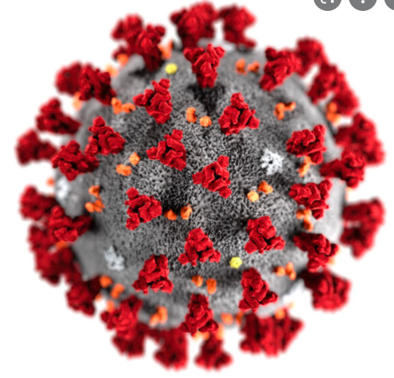

What no one was expecting….

Slide 9
Understanding clinical escalation:
'Escalation is safety critical communication to achieve a timely senior response for a complication or evolving clinical situation’
Right person, Right place, Right Response, Right time?
Identify
Correctly recognise deviation from normality
Communicate
Closed loop structured communication
Act
Appropriate response and speed
Appreciation of risk factors
Flattened MDT hierarchy
Infrastructure – staff / theatres available
Assertive escalation / receptive action
Be aware of when you are escalating
Notes:
3 basic steps and preconditions that have to happen in effective clinical escalation:
Identify – that there is a clinical problem/deterioration
Communicate – escalation the concern
Act – get the appropriate response in the right time
Anything else?
Intrinsic factors – confidence, motivation, competence
Extrinisic factors
Environment etc

Slide 10
Quality Improvement Process
Diagnostic phase
Identify what needs to change (review serious incident forms, observation of practice)
Exploring barriers and facilitators of the desired behaviours (interviews or focus groups with staff)
Design phase
Developing impactful interventions to support/enable practice change
Implementation
Put the agreed intervention{s) into place following agreement from the whole team
Interventions co-developed with staff to ensure buy-in
Consultations with women
Targeting the factors known to hinder and/or facilitate the change
Develop any training materials/resources required for roll-out
Deliver any training required to teams to carry out the desired behaviours
Baseline questionnaire with all staff prior to roll out
Repeat questionnaire following period of implementation (e.g. after 3 months)
Qualitative interviews/focus groups with selected staff to further explore the implementation of the intervention
How often is the behaviour happening/not happening, team views on the reasons why using the COM-B model
Evaluation
Spanned covid-19 pandemic
Nov 2020-Feb 2021
March 2021-September 2021
Ongoing throughout. All contained in final report on RCOG website

Slide 11
Change ideas and change methodology
Campaign: Identify - Communicate - Act (Response)
IDENTIFY –
Team of the shift: Use checklist for setting up team of the shift – with visuals and prompts.
Knowledge and skills: Develop educational material re knowledge, tools, escalation process: increasing conscious awareness
ACT (AND RESPOND) - Teach or Treat
Respond kindly, quickly and appropriately using
TEACH “Tell me what you think and why, I’ll do the same so we can discuss”
or
TREAT “Lets take action to the clinical escalation”
COMMUNICATE -Use concise, safety critical language to communicate concerns and SBAR.
Begin conversation with:
“I need advice”
“ I need to inform”
“I need a response”

Slide 12
Overall Aim: To Improve Clinical Escalation
To reduce delays in escalation by improving the response escalation and action taken
To standardise the use of safety critical language
To reduce feelings of hierarchy, creating a supportive environment which empowers staff of all levels to speak up when they identify deterioration or a potential mistake
To promote a culture of respect, kindness and civility amongst staff members, normalising positive feedback and saying thank you to each other
To improve the ways in which we listen to women

Slide 13
Interventions Developed and Tested Using QI Methodology
Teach or Treat
Learning conversations
AID
Safety critical language
TOS
Promoting excellence in team working
All aim to improve clinical escalation, psychological safety for staff, and provide a structured way of improving communication and behaviour change.

Slide 14
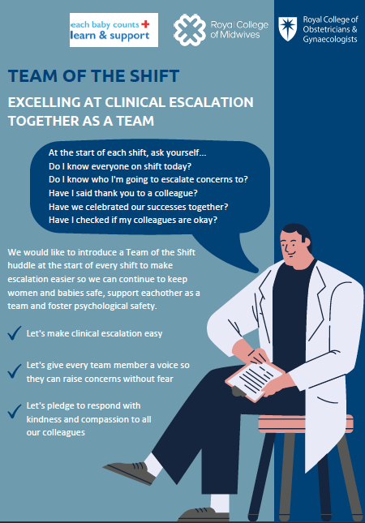
Team of the Shift
Standardises a multidisciplinary team huddle at the start of every shift to promote optimal teamwork.
Huge variation around the country.
Emails, proformas, posters, business cards used to promote its use
Promotes positive workplace culture and behavioural norms – every huddle follows the same format

Slide 15
Team of the Shift - Aims
Identify all the staff on shift that day, including job role and length of shift
Identify the team leaders, including those who will be escalated to
Flatten hierarchies by giving everyone a voice and encouraging first name introductions
Support staff by creating psychological safety, encouraging them to raise concerns and speak up
Identify anyone in the team who may need additional support that day
Identify learning needs for trainees and students
Create a positive workplace culture by thanking staff and celebrating successes
Foster a culture of kindness and civility
Eliminate cultures of criticism, including “toxic handovers”
Foster a sense of teamwork, mutual respect, and create a shared mental model of the team’s workload, priorities, and potential challenges that shift

Slide 16
Team of the Shift– Evaluated Benefits
Easy to implement and sustain
It opens discussions around creating psychological safety “learning to make time to introduce people to one another and talk about escalation to in turn creates safer shifts”.
Impacts positively on staff during a time of high workload and low morale
Makes escalation more efficient
Builds trust, respect, and a sense of unity.
Identifies individual needs within the team to plan areas of support as well as providing a positive and supportive way to start a shift.
Empowers junior staff
Introductions were noted as particularly helpful to avoid confusion and improve safety on the unit.

Slide 17
AID – Advice, Inform, Do

Slide 18
Advice, Inform, Do:
AID is as a clear and simple communication tool which initiates escalation conversations using 3 simple phrases:
“I am asking you for Advice”,
“I am Informing you” and
“I need you to Do…”
It is designed to precede the commonly used SBAR (situation, background, assessment, recommendation)
It can also be used “in reverse” – ie if it is unclear what response the person escalating is looking for, the clinician being escalated to can ask the following:
“Are you asking me for Advice”,
“Are you Informing me”,
“Do you need me to DO something / what would you like me to DO”?
It is not expected that clinicians force these exact phrases into conversations, but that the principles of “ADVICE, INFORM, DO” are used as a framework when escalating.

Slide 19
Aims / Use
Clearly identify when escalation is taking place
Elicit a time critical response, reducing delays
Help prioritisation for clinicians who may receive multiple escalations within any given shift (band 7 midwifery co-ordinators, consultants)
Empower junior staff
Used…..
At the outset of all escalation conversations between ALL members of the MDT
Particularly helpful when escalating to non resident clinicians (usually consultants) and during periods of high activity

Slide 20
Evaluated Benefits of AID
Simple, empowering, works as a safety net – therefore well received, particularly by the people being escalated to.
Streamlines communication and creates escalation awareness
Improves responses and decision making
Improves communication and teamwork
Flattens hierarchies

Slide 21

Teach or Treat
‘Teach or treat’ is a communication process which enables team members to explore their colleagues clinical decision-making process in a respectful dialogue that encourages people to reflect on their own decision-making process. It can help solve disagreements by empowering staff and improving their relationships.
It promotes a collaborative understanding about the unravelling clinical situation, learning and understanding from everyone’s perspectives, and encourages respect for the opinion of others.

Slide 22
Aims of Teach or Treat:
Promote respectful conversations between staff members so that junior members of the team are not afraid to be unsure, be wrong, or escalate concerns.
Promote shared understanding of a clinical situations from different clinicians’ perspectives
Put the woman at the heart of the decision making and information giving
Identify when escalation has taken place
Promote a flattened hierarchy, a culture of learning and of mutual respect
Empower all members of the team to respectfully challenge if they think another member may be making a mistake

Slide 23
When is it used?
When implemented in units around the country, it was most widely used when interpreting CTGs. However, it can be used in any clinical situation.
On ward rounds
When performing “fresh eyes” if there is disagreement between the two clinicians
When escalating clinical concerns
In CTG / intrapartum care teaching

Slide 24
Benefits of Teach or Treat:
Widely accepted as a positive intervention “it makes you really think about your behaviours and actions, and promotes you to have better conversations”
It improves multi-disciplinary relationships
It makes staff feel safe
It flattens hierarchies and empowers junior staff
It promotes staff to reflect on their decisions and create collaborative care plans
Women who witnessed the conversations received reassurance and better understandings of their own situation, whilst describing the conversations as respectful.

Slide 25
Challenges of Change
Time, change fatigue
Low morale
Cynicism
Some staff groups more hesitant than others
BUT –
Interventions are designed to be simple
Staff feel safer therefore highly acceptable
Overall package leads to a more positive workplace culture

Slide 26
What Have We Learnt?
The impact of local diagnostics
Maternity units across the country have more in common than they realise
The impact of human factors and safety thinking underpinning interventions
The impact of “campaign methodology”
Break large ambitions into small, manageable projects
The importance of the “bottom up” approach
Measure improvement and celebrate successes
Cake is a key safety intervention in maternity – we need to look after our staff

Slide 27

And Finally…..
The human side to all this work
A big team of dedicated professionals who really want to make a difference
A LOT of cakes baked
During the most challenging time of people’s lives
THANK YOU to an inspiring group of people

Slide 28
Thank you
ebc_learnandsupport@rcog.org.uk
Enabling maternity teams to work safely

