Slide 1
Recognition of Deteriorating Obstetric Patient
Notes:
Why is it important
2011 CEMACE report highlighted
failure to recognise the signs and symptoms of potentially life threatening conditions
delay in acting on the findings and seeking help from appropriate specialists of particular concern
As one of the major contributors to avoidable deaths

Slide 2
Learning Objectives
To recognise the importance of the early recognition of the deteriorating obstetric patient
To know the changes in the normal physiological parameters in pregnancy and the implications of these in assessing the pregnant patient
To understand the approach to monitoring those at risk of deterioration using the modified early warning score for obstetrics (MEOWS)
To be aware of when to escalate using ‘SBAR’
To recognise ‘red flag’ symptoms in obstetrics
To know the immediate management of the deteriorating patient

Slide 3
Physiological Changes in Pregnancy
 | Changes in Pregnancy | Implications
Breathing
Circulation
Notes:
In small groups/ shout out

Slide 4
Physiological Changes in Pregnancy
 | Changes in Pregnancy | Implications
Breathing | ↑minute ventilation 40-50% ↑tidal volume ↑O₂ Requirement by 20% Diaphragm splinting ↓ Functional residual capacity
Circulation | ↑Heart rate 16% ↑ circulating volume by 40% ↑ Cardiac output BP ↓ in early pregnancy

Slide 5
Physiological Changes in Pregnancy
 | Changes in Pregnancy | Implications
Breathing | ↑minute ventilation 40-50% ↑tidal volume ↑O₂ Requirement by 20% Diaphragm splinting ↓ Functional residual capacity | Subjective feeling of SOB ↑RR is an early & sensitive sign of deterioration pH is more alkalotic (7.40-7.46) than in non pregnant state (7.34-7.44)
Circulation | ↑Heart rate 16% ↑ circulating volume by 40% ↑ Cardiac output BP ↓ in early pregnancy | Loss of blood volume may not be recognised ↓ BP is a late sign (30-50% loss) (↑HR, ↑RR, ↓PP, ↓FH, ↓CR, pallor, oliguria, anxiety)
Notes:
It can be harder to recognise a deteriorating patient
Presentation may be atypical or insidious
Any woman may deteriorate and it cannot always be predicated
Relative rarity of such events
as signs and symptoms may be attributed to normal changes of pregnancy
Those not trained in pregnancy specific changes may misinterpret findings-need to bear in mind physiological changes
MEOWS chart with pregnancy specific ranges for triggers

Slide 6
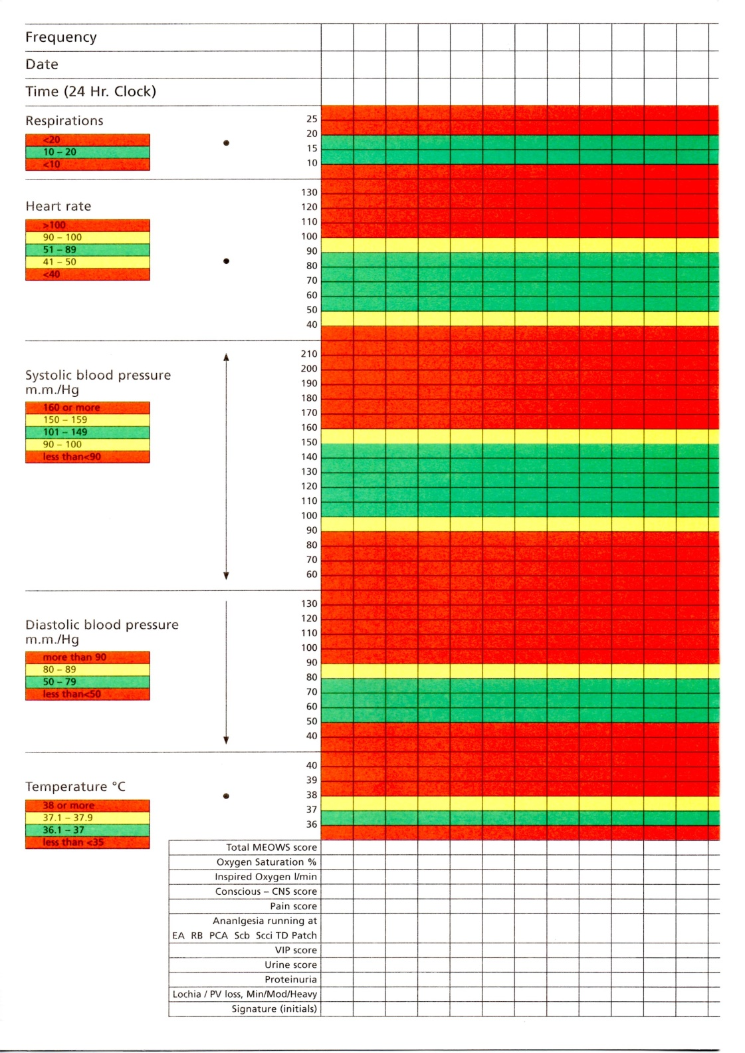
Modified Early Warning Systems (MEOWS)
Temperature
Respiratory Rate
BP: correct cuff size
Pulse
Conscious level: AVPU score
Pulse oximetry
Urine output
Pain score
VIP score (Visual infusion phlebitis)
Notes:
Pregnancy and labour are physiological events however regular monitoring of observations will aid in the recognition of changes in condition
Improve detection of life threatening illnesses
All women who enter an acute hospital setting should have their observations recorded on a MEOWS chart (NICE 50)
Prompt early referral to an appropriate practitioner who can undertake a full review, order appropriate investigations, resuscitate and treat as required
So what should be on the MEOWS?
Balance between comprehensive and too much information which can distract from the important information
Scores outside of the normal ranges are recorded in the coloured zones of the chart and trigger a response from the medical staff
Escalation policy is integral to MEOWS scoring
Frequency of observations is determined by
Risk status
Diagnosis
Reason for admission
Initial observations of admission
Bear in mind frequency when determining the location of the patient

Slide 7
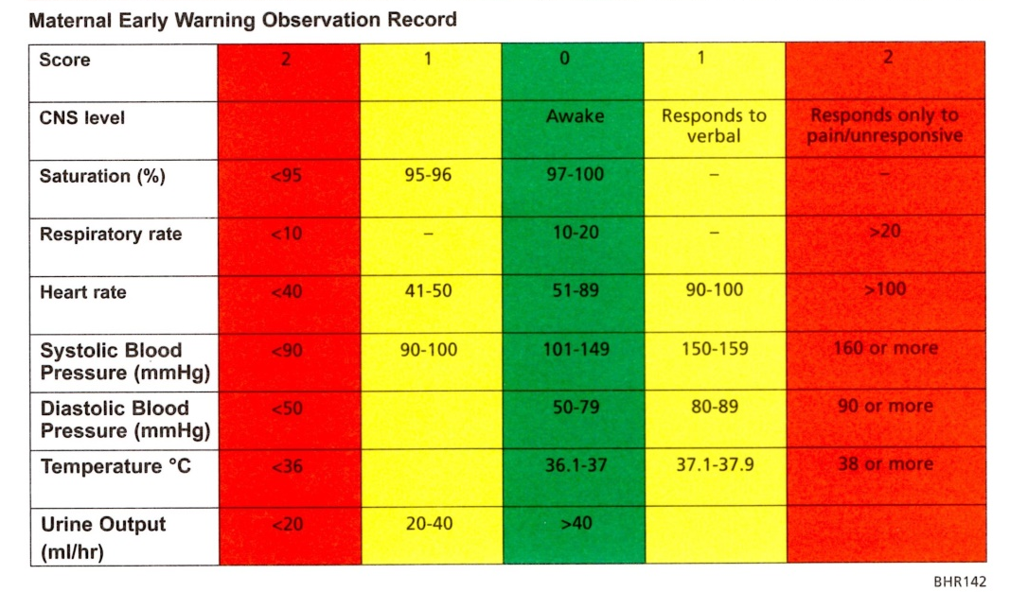
How to Score the MEOWS

Slide 8
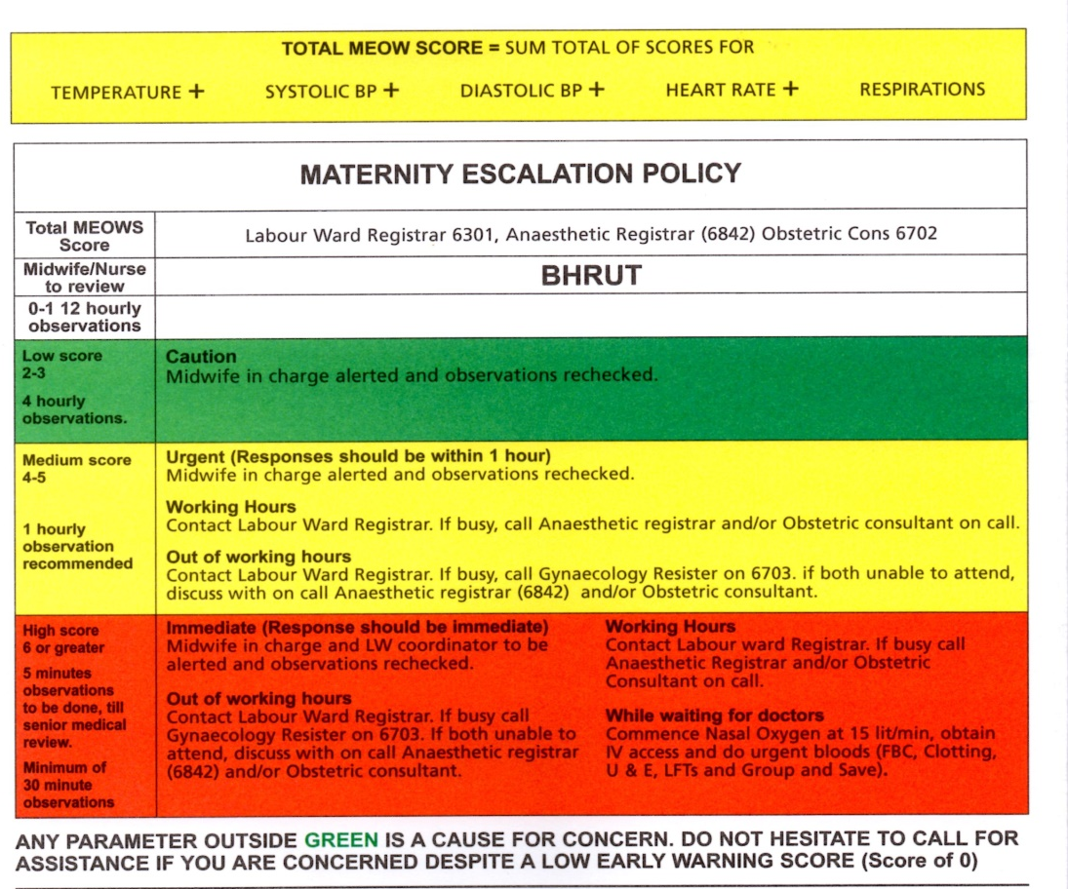

Slide 9
SBAR
Situation
Background
Assessment
Response

Slide 10
Red Flags

Slide 11

Pyrexia
Pyrexia >38⁰C
Pulse rate sustained >100bpm
Respiratory rate > 20 breaths per minute
Abdo or chest pain
Diarrhoea and/ or vomiting
Reduced FM/ absent FH
SROM or significant vaginal discharge
Uterine or renal angle tenderness
Notes:
Sign of sepsis
However absence doesn’t exclude as may have received paracetamol
Absence of pyrexia with sepsis is worrying

Slide 12
Breathlessness
Headache
Sudden onset
Associated with chest pain
Orthopnoea, paroxysmal nocturnal dyspnoea
Post natal (less common)
New onset wheeze
Sudden onset
Associated neck stiffness
‘Worst headache ever’
Any neurological sign
Notes:
Breathlessness
Usually gradual onset
Worse on talking
May be cardiac, respiratory or metabolic
Headache
Common and hard to manage
Usually benign but can be serious

Slide 13
Abdo Pain & Diarrhoea
Anxiety & Distress
Sudden onset
Fainting and dizziness
Severe pain without an established cause
Need to consider non-obstetric causes
Abnormal FH
Is there are clear pathway to symptom production
Is there a known psychiatric history & is it relevant now?
Do the symptoms represent a marked change from normal function?
Are the only psychological signs behavioural & non-specific e.g. distress & agitation?
Notes:
Adbo pain & diarrhoea
Fainting and dizziness may be due to intra-abdominal blood loss
May be due to intraabdominal sepsis
Areas of max tenderness shift due to organ displacement
Uterus inhibits abdo palpation
Peritoneum is less sensitive in pregnancy
Omentum cannot wall off and contain local inflammation
Anxiety and distress
May be attributed to ‘baby blues’ which means serious pathology can go unrecognised

Slide 14
Immediate Measures
Call for senior help & consider location
Increase observation frequency
Monitor pulse oximetry +/- O2 if needed
If AN left lateral tilt & commence CTG
Consider position eg sit up
Ensure safe environment eg cot sides
Check IV lines
Check drug chart & ensure medications have been given
Ensure outstanding lab results are obtained
Bring ECG machine, ABG syringes & venepuncture equipment
Maintain notes
Keep patient and family informed
Notes:
There are some simple measures that you can take whether you are a midwife or a doctor whilst waiting for more experienced help

Slide 15
References
Vaughan D et al (2010) Handbook of Obstetric High Dependency Care
Paterson Brown S & Howell C (2014) Managing Obstetric Emergencies & Trauma
CEMACE (2011) The Eighth Report of the Confidential Enquiries into Maternal Deaths in the United Kingdom

