Slide 1
Urogynaecology
Mr Jeremy Gasson
© Royal College of Obstetricians and Gynaecologists

Slide 2
Declaration of Interest
Conflict of interest - None

Slide 3
Practice in UK
National Institute for health and Care Excellence – NICE
Urinary incontinence: The management of urinary incontinence in women
NICE guidelines [CG171] Published date: September 2013

Slide 4
What is Urogynaecology
Congenital anomalies
Incontinence
Fistulae
Genital prolapse
Voiding difficulties
Neuropathy
Lower Urinary Tract Symptoms (LUTS)
UTI
Anal sphincter injuries

Slide 5
Congenital Anomalies
Lesions often affect multiple systems
Often present to Urologist e.g. Horseshoe Kidney
Management of dubious sexuality or reconstructive surgery e.g.Haematocolpos

Slide 6
Incontinence
“involuntary loss of urine which is objectively demonstrable and a social or hygiene problem”
Prevalence up to 18% women

Slide 7
Types of Incontinence
Stress Urinary Incontinence
Urodynamic Stress Incontinence
Urgency Incontinence
Urgency, frequency, nocturia (OAB)
Detrusor overactivity
Mixed Incontinence
Continuous
fistulae

Slide 8
Urodynamic suite

Slide 9
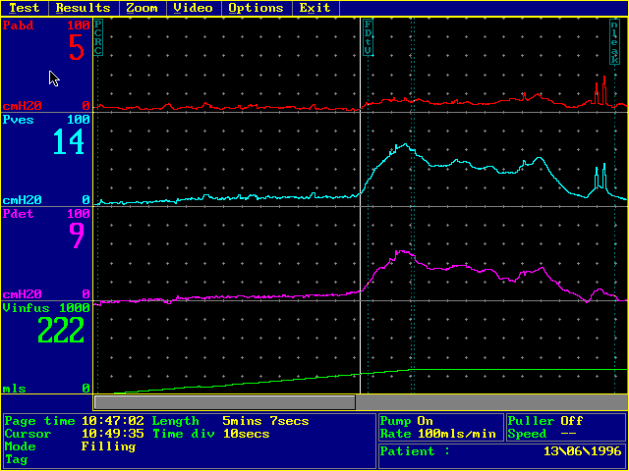
Detrusor overactivity

Slide 10
Management
Stress Urinary Incontinence
Overactive Bladder Syndrome (OAB)
Continuous

Slide 11
Stress Urinary Incontinence
Continence advisor / Physiotherapist
Supervised PFE, electrical stimulation
Drug therapy
Duloxetine
Surgery
Mid Urethral Tapes e.g. TVT*
Transobturator Tapes*
Open surgery e.g. Colposuspension* Fascial Slings*
Injectables e.g Collagen
Artificial sphincter

Slide 12
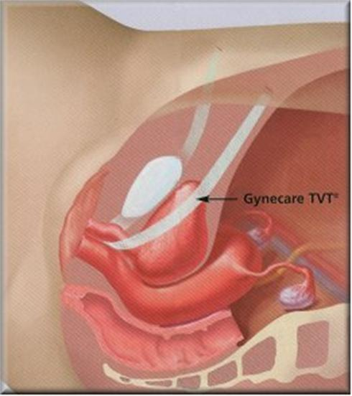
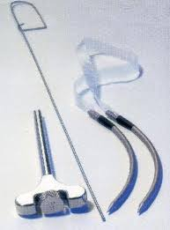
Mid-urethral sling
Tension-free vaginal tape®
Obturator approach

Slide 13
Burch Colposuspension

Slide 14
Fascial sling

Slide 15
OAB
Continence Advisor
Bladder training, fluid management, PFE
Drug therapy
Antimuscarinic agents
Mirabegron - selective β₃-adrenoceptor (AR) agonist
Desmopressin, oestrogens

Slide 16
OAB - NICE
oxybutynin (immediate release), or
tolterodine (immediate release), or
darifenacin (once daily preparation)
If the first treatment for OAB or mixed UI is not effective or well-tolerated, offer another drug

Slide 17
OAB
Surgery
Botulinium toxin,
Sacral Nerve Stimulation,
Bladder augmentation,
Urinary diversion

Slide 18
Botulinum toxin A
200 units
Teach CISC & accept risk
Typically, 10 to 30 injections sites are used
local anaesthetic
Improvement takes up to 2 weeks to be seen
Treatment effect will commonly last 6 months to 9 months.
Repeated treatments may be needed

Slide 19
NICE Pathway for OAB

Slide 20
Fistulae
Abnormal communication between 2 epithelial surfaces
Causes include:
Surgical, Obstetric, Radiation, Malignancy, Inflammatory bowel disease, Miscellaneous e.g. TB, Pessary, Coital injury

Slide 21
Fistulae
Mainly iatrogenic e.g.post hysterectomy
Consider risk management issues
Manage within a MDT
Catheterise
Find hole and close
Vaginal, abdominal or laparoscopic approach
Barrier between epithelial surfaces
Should be performed in large units with experienced surgeons

Slide 22
Investigations
Dye studies (3 swab test)
Radiology
CT Cystogram
+/- Renogram
EUA & Endoscopy

Slide 23
Management
Catheterisation 8-12 weeks
EUA / Cystoscopy +/- Retrograde
Skin care
Antibiotics
Surgery
Abdominal, vaginal,laparoscopic
Timing – delay for 12 weeks
interposition grafting e.g Martius graft

Slide 24
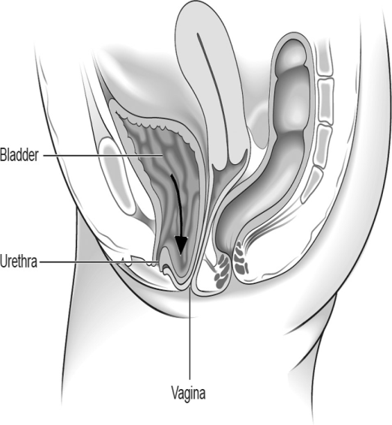
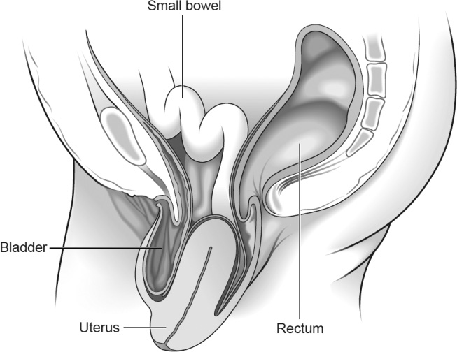
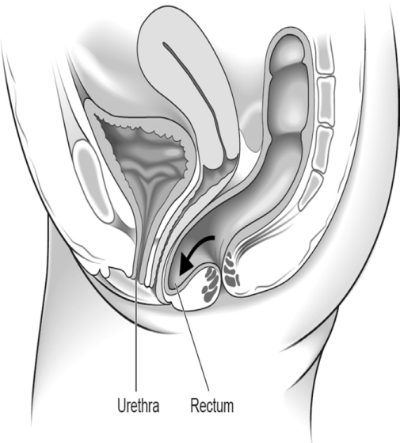
Prolapse

Slide 25
Pelvic Organ Prolapse
20% major gynae surgery
1/3 reoperations
Woman’s Lifetime risk of undergoing surgery 11%

Slide 26
Risk Factors
Menopause
Multiparity
Obesity
Congenital e.g. ehlers-danlos
Chronic cough
Constipation
Heavy lifting

Slide 27
POP
Symptoms
Signs

Slide 28
POP
Symptoms
Signs
Feeling of lump
Vaginal ache
Backache
Sexual dysfunction e.g. looseness
Urinary &/or faecal symptoms
Physical examination
General (BMI, dexterity)
Abdominal examination
Pelvic examination
POP-Q
Simplified POP-Q
Baden Walker

Slide 29
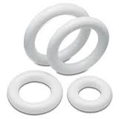
Management
Nil
Pessary
Surgery
Depends on type and severity
Repairs, Hysterectomy, colpocliesis, sacrospinous ligament fixation, sacrocolpopexy, Mesh

Slide 30
Cochrane review – Data published to August 2012
Maher C, Feiner B, Baessler K, Schmid C. Surgical management of pelvic organ prolapse in women. Cochrane Database of Systematic Reviews 2013, Issue 4. Art. No.: CD004014. DOI: 10.1002/14651858.CD004014.pub5.
Fifty-six randomised controlled trials were identified evaluating 5954 women.

Slide 31
Anterior Compartment prolapse
21 trials
10 compared native tissue repair Vs graft

Slide 32
Anterior Compartment
Recurrent prolapse
Awareness of prolapse
Reoperation rate
QoL scores
Blood loss
Operating time
De novo stress incontinence
Erosion rate for Mesh
Higher in native tissue repair
Higher in native tissue repair
Similar in both native & graft
No difference
Higher in TO mesh than native tissue
11.4% - surgery performed in 6.8%

Slide 33
Posterior compartment 3 trials looked at native tissue compared to polypropylene mesh kits in all compartments
Awareness
Recurrence rate on examination
Mesh erosion rate
Surgical correction of erosion
Reoperation rate
No difference
Higher in native tissue group
18%
9%
Higher in Mesh repair group (11% Vs 3.7%)

Slide 34
Vault Prolapse
Abdominal Sacrocolpopexy
Sacrospinous fixation
Associated with lower rate of recurrence on examination
Lower incidence of dysparunia
Shorter operating time
Faster return to normal activity
Cheaper cost

Slide 35
Conclusions
Sacrocolpopexy has superior outcomes Vs Sacrospinous fixation & TV Mesh
Balance against longer operating time, longer recovery, increased cost
Mesh in anterior prolapse reduces risk of recurrence on examination & reduction in awareness of prolapse.
Balance against longer operating time, Blood loss, Exposure and reoperation rate
Evidence against use of grafts in posterior prolapse
OVERALL NOT ENOUGH EVIDENCE AVAILABLE

Slide 36
Perineal injuries
Faecal incontinence may be as high as 7%
Risk of 3rd & 4th degree tears 1% of vaginal deliveries
Classification of 3rd / 4th degree tears:
3a, 3b, 3c, 4
Risk factors:
Birth wt >4kg, OP position, nulliparity, IOL, 2nd stage >1hr, shoulder dystocia, forceps delivery

Slide 37
Repair of 3rd / 4th degree tears
Repair in theatre
Appropriate surgeon
Regional / general anaesthetic
IAS separate if identifiable
End to end or overlap technique
Suture material
Antibiotics & Laxatives
Post operative physiotherapy

Slide 38
Outcome / Future
60-80% asymptomatic at 1 year
Counselling re subsequent pregnancy & delivery
Review in specialist clinic

Slide 39
Any Questions?

